Slide 1
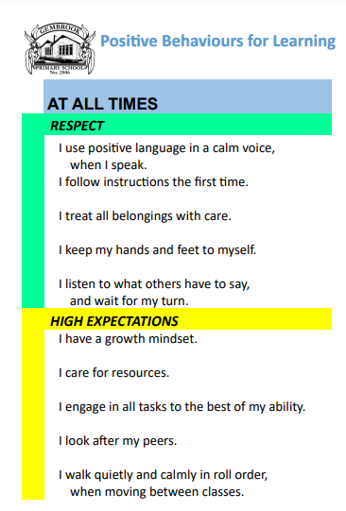
Grade 5/6 Newsletter
Term 1
Welcome!
Curriculum Links:
For more information on the curriculum for your child, please visit the ‘curriculum’ section on our school website: https://www.gembrookps.vic.edu.au/wp/ and the Victorian Curriculum: https://victoriancurriculum.vcaa.vic.edu.au
Welcome back to school! We hope that you all had a relaxing break and are ready for a busy and engaging term 1. Our initial focus has been establishing classroom routines, setting expectations, and developing a strong sense of belonging. Please make sure you carefully read the term dates and keep an eye on Compass for important events.
We will continue to acknowledge positive behaviours by rewarding students with gem chips! Please ask your child about their PBL gem chips.
We have attached the ‘At All Times’ matrix so you can discuss these positive behaviours at home.
School Photography and Filming Permission
We request that all parents complete our School Photography and Filming Permission form. You can do this through Compass, or fill in a form from the office.
We acknowledge and pay our respect to the past, present and future Traditional Custodians and Elders of this nation, and the continuation of the cultural, spiritual and educational practices of Aboriginal and Torres Strait Islander peoples. (Wording sourced from Reconciliation Australia reconciliation.org.au)
Contact
Teachers are available after school on Monday, Thursday, and Friday for arranged meetings, or alternatively you can call or email the school.
(03) 5968 1313 gembrook.ps@education.vic.gov.au.
Values: RESPECT and HIGH EXPECTATIONS
Vision: To provide every student with every opportunity to be the best they can be.
Mission Statement: A View To The Future - Gembrook Primary School is a vibrant and aspirational education community, providing a safe and supportive learning environment that enables a personalised, engaging and challenging learning program. Our objective is for students to achieve the academic, social, emotional and physical growth to thrive in a global society.

Slide 2
Grade 5/6 Newsletter
Term 1
Dates
Literacy
Date | Event
7th February | Prep and new families morning tea
12th, 14th & 20th February | Getting to know you Interviews
13th February | 3-6 Swimming Carnival
23rd February | Curriculum Day
4th March | Athletics Carnival
11th March | Labour Day
13th – 21st March | NAPLAN
25th March | Buddy BBQ
28th March | Last Day of Term 1
In literacy, students will begin by delving into narrative texts, exploring various planning processes and strategies. Students will brainstorm topics they are passionate about, and will look at varying ways in which they can create detailed plans. Following the conclusion of narrative writing, students will explore creating persuasive texts. Here, they will look at persuasive devices, and strategies used to convince a target audience. Throughout each mode of writing, students will follow the writing process, looking at ways to plan, draft, edit, revise, and publish pieces, including both by hand and digitally. They will use their writing folders to move through each stage of the writing process.
In their writing wallets, students will have the opportunity to work on a short written text, in which they will receive explicit instruction on the editing and revision process. Students will spend a short period of time practicing a skill, and working towards hitting the success criteria for the lesson. Following this, students will have the remainder of the lesson as an open writing session, where they will have the opportunity to continue a piece that they are passionate about.
Reminders
We are now in term one! So it is expected that students wear broad brimmed hats at recess and lunch, otherwise they will have to play
undercover. We will also encourage students to bring sunscreen to school to apply each day.
Inquiry
This semester, students will be learning about colonial Australia. Students will learn about the development of Australia as a nation, particularly after 1900. During our studies students will learn about the perspective of First Nations Australians and their contribution to Australia as nation.

Slide 3
Grade 5/6 Newsletter
Term 1
Numeracy
Timetable
 | 5/6A | 5/6B | 5/6C
Tues | Art | P.E. | Music
Wed | P.E. AUSLAN | Music Art | AUSLAN P.E.
Thur | Music | P.E. | Art
In number, students will begin the year by learning about place value. They will learn about rounding and expanded notation, as well as number patterns (square, triangular, prime, and composite). In our measurement and geometry lessons, students will begin by exploring shapes and angles. They will learn about how 3D shapes can be deconstructed into nets. They will also learn how to accurately measure angles, compare angles and how to classify angles. Our statistics and probability lessons will begin by looking into probability with fractions, decimals, and percentages. Students will list the possible outcomes of events and learn how likelihood can be measured by fractions and percentages.
We will continue to complete our DPATS (Digital Portfolio Assessment Tasks), so please keep a lookout for these on Compass.
Assembly: Fridays at 2:30, unless stated otherwise. Please look out for Compass notifications.
Reminders
Diaries and folders: Diaries act as an important communication tool. Please remind your child to bring theirs daily. Uniform: Students are expected to be in full school uniform at school.
Science
Students will study biological science, in which they will plan and conduct an investigation, of whether or not a feature of an animal is an adaptation for surviving in a desert environment.

